Slide 1
Human Data Analytics A.Y. 2022/2023
Final Project: Lymphoma Subtype Classification
Gianpietro Nicoletti 2053042¹ , Stefano Campagnola 2058080²
¹Department of Information Engineering, ICT for Internet and Multimedia, University of Padua
²Department of Physics and Astronomy, Physics of Data, University of Padua

Slide 2
What is Lymphoma?
Lymphoma is a type of cancer that affects the lymphatic system
Digital pathology (DP) involves the capture, storage, sharing, and analysis of high-resolution images of microscopic slides
Digital pathology enables the application of computer algorithms and artificial intelligence (AI) techniques for automated analysis of lymphoma slides

Slide 3
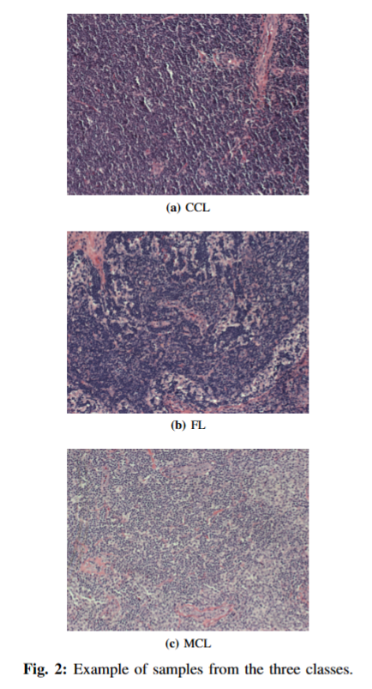
Dataset
374 RGB images from the National Institute of Ageing (NIA) of size 1388x1040
Three classes:
Chronic lymphocytic leukaemia (CLL)
Follicular lymphoma (FL)
Mantle cell lymphoma (MCL)
Train/validation/test splitting:
70% train
10% validation
20% test

Slide 4
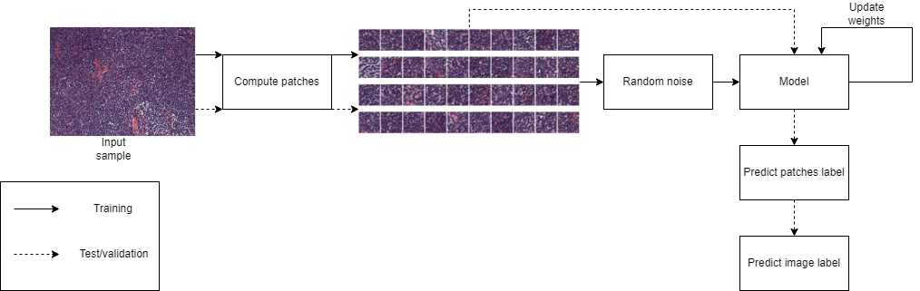
Pipeline

Slide 5
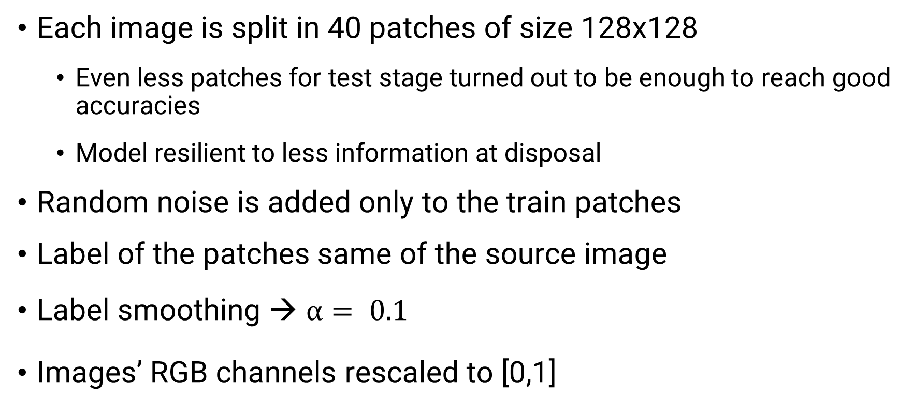
Data preprocessing
Each image is split in 40 patches of size 128x128
Even less patches for test stage turned out to be enough to reach good accuracies
Model resilient to less information at disposal
Random noise is added only to the train patches
Label of the patches same of the source image
Label smoothing → $α= 0.1$
Images’ RGB channels rescaled to [0,1]

Slide 6
Self-supervised learning
Self-supervised learning is a machine learning technique in which a model learns to extract meaningful representations or features from unlabelled data
Pretext task is a side objective of the model that guides the achievement of the main task:
Pretext task → image reconstruction
Main task → image classification
In our case: image reconstruction task will help our model on building an efficient latent representation

Slide 7
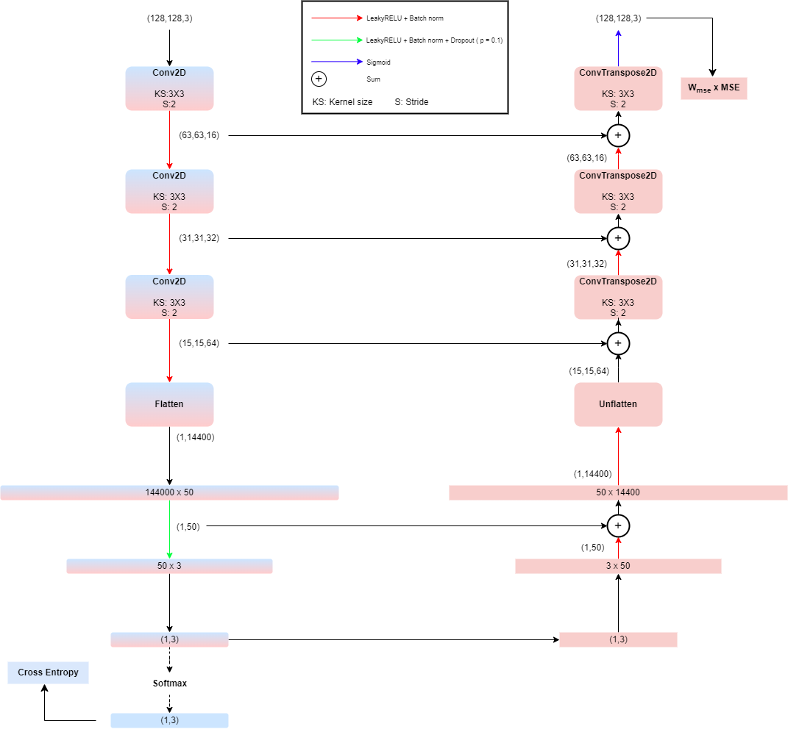
Architecture
Classifier → encoder part + softmax
Autoencoder → encoder + decoder + sigmoid
Skip connections inspired by U-net
Our baseline

Slide 8
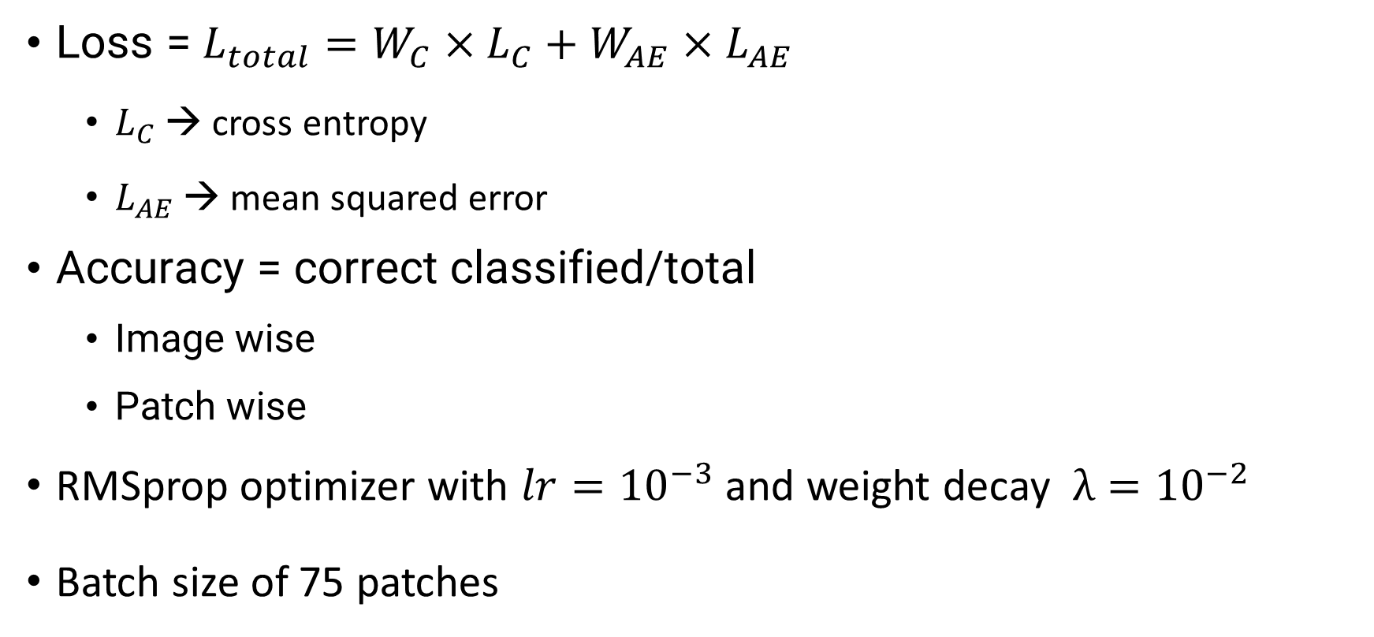
Training setup
Loss = $L_{total}=W_{C}×L_{C}+W_{AE}×L_{AE}$
$L_{C}$ → cross entropy
$L_{AE}$ → mean squared error
Accuracy = correct classified/total
Image wise
Patch wise
RMSprop optimizer with $lr={10}^{−3}$ and weight decay $λ={10}^{−2}$
Batch size of 75 patches

Slide 9

Vanilla prediction algorithm
Vanilla approach:
$o_{img,patch}$ → embedding of a patch belonging to an image
${\hat{y}}_{img,patch}=\text{arg} \text{max}\left(o_{img,patch}\right), { \hat{y}}_{img,patch}∈\{0,1,2\}$
${\hat{y}}_{img}=\text{arg}\max_{i}\left(count_{img}\left(i\right)\right), i∈\{0,1,2\}$
Ambiguity: $count_{img}\left(i\right)=count_{img}\left(j\right), i ≠j$

Slide 10
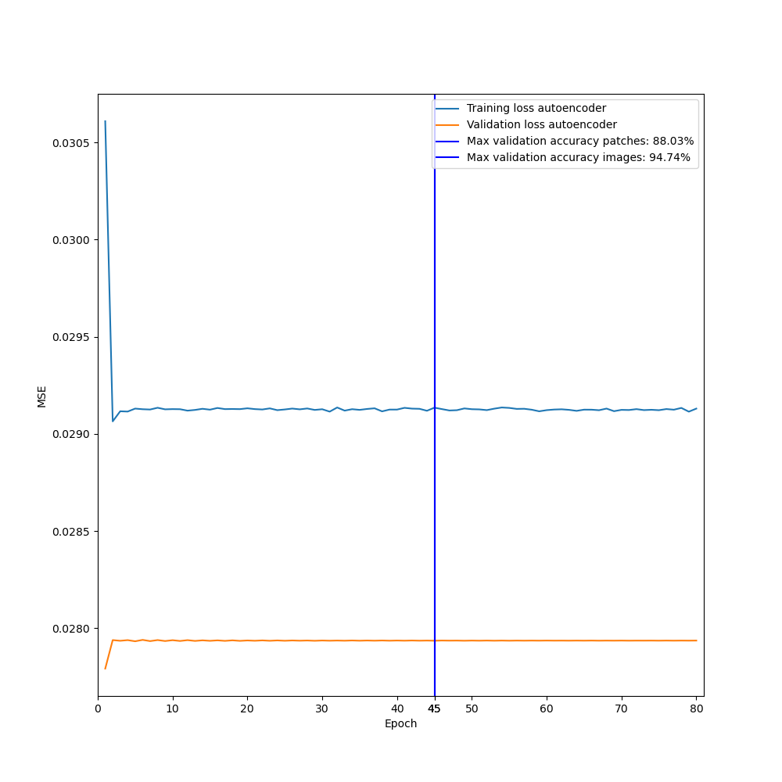
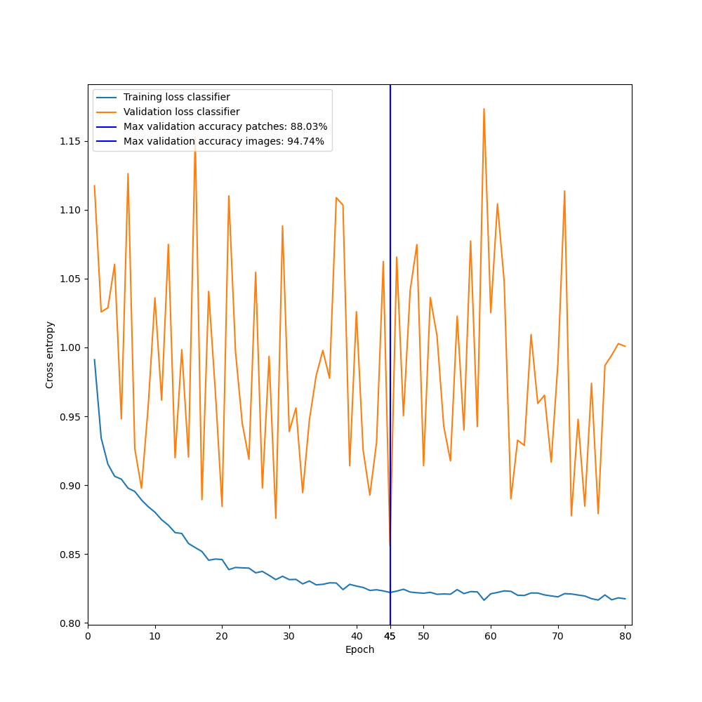
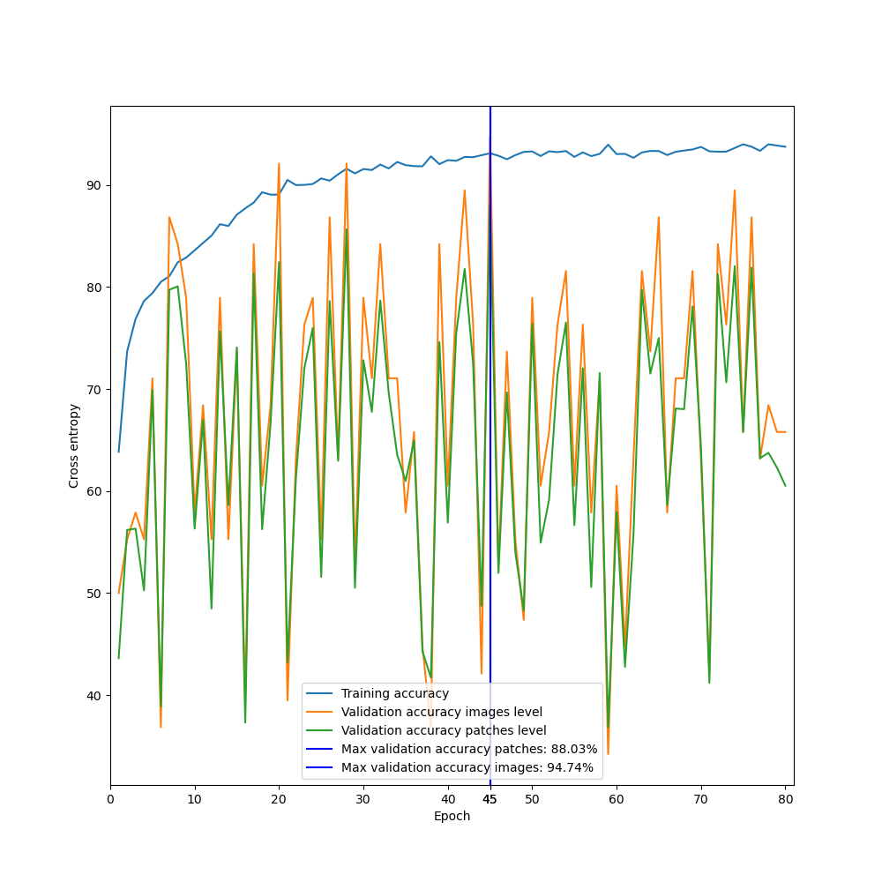
Baseline
MSE
Cross entropy
Accuracy

Slide 11
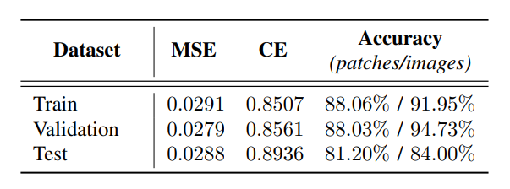
Baseline

Slide 12
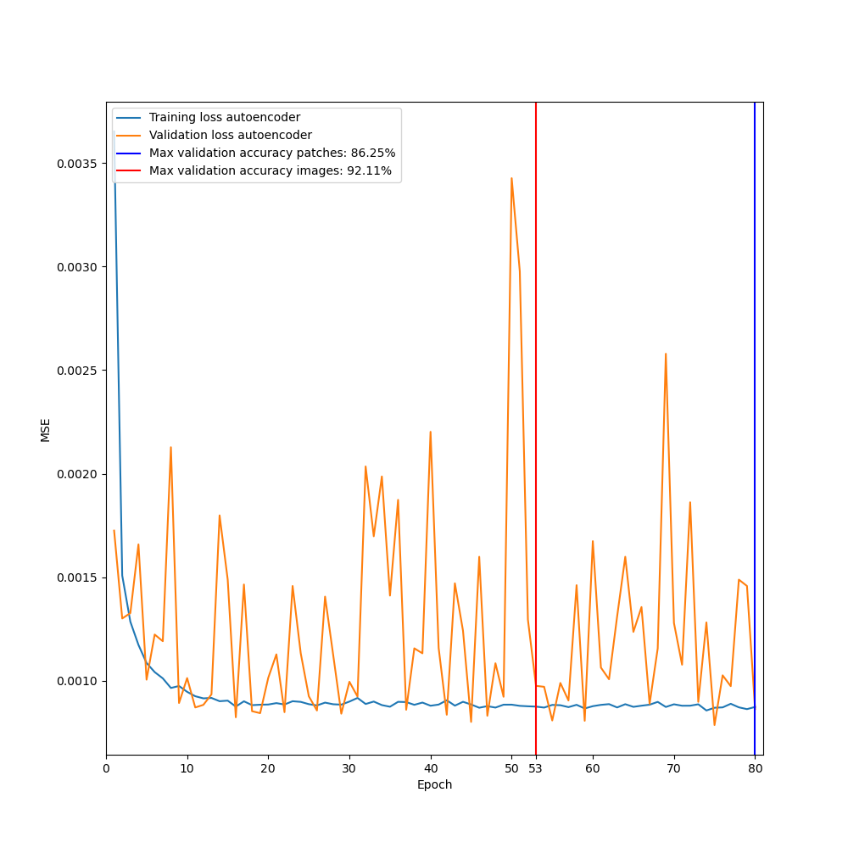
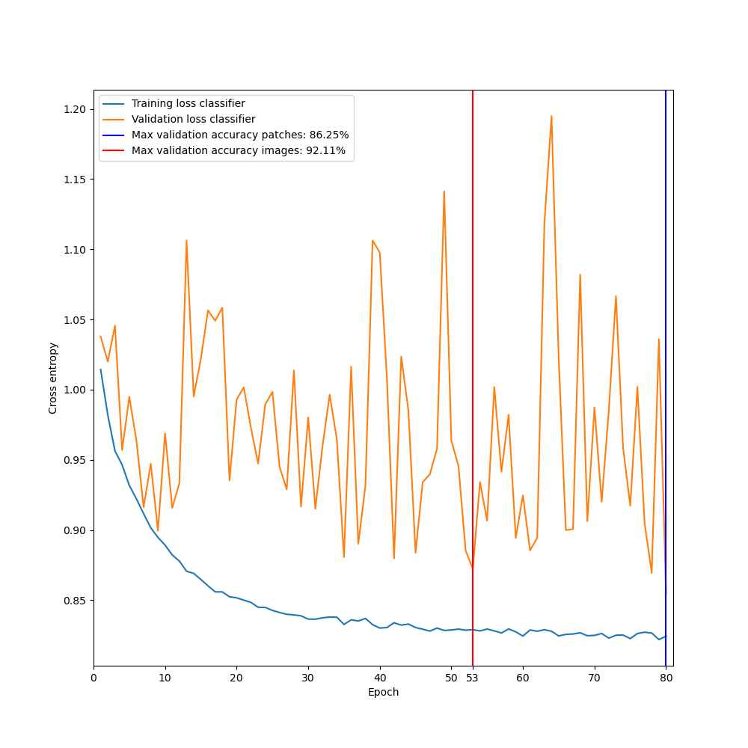
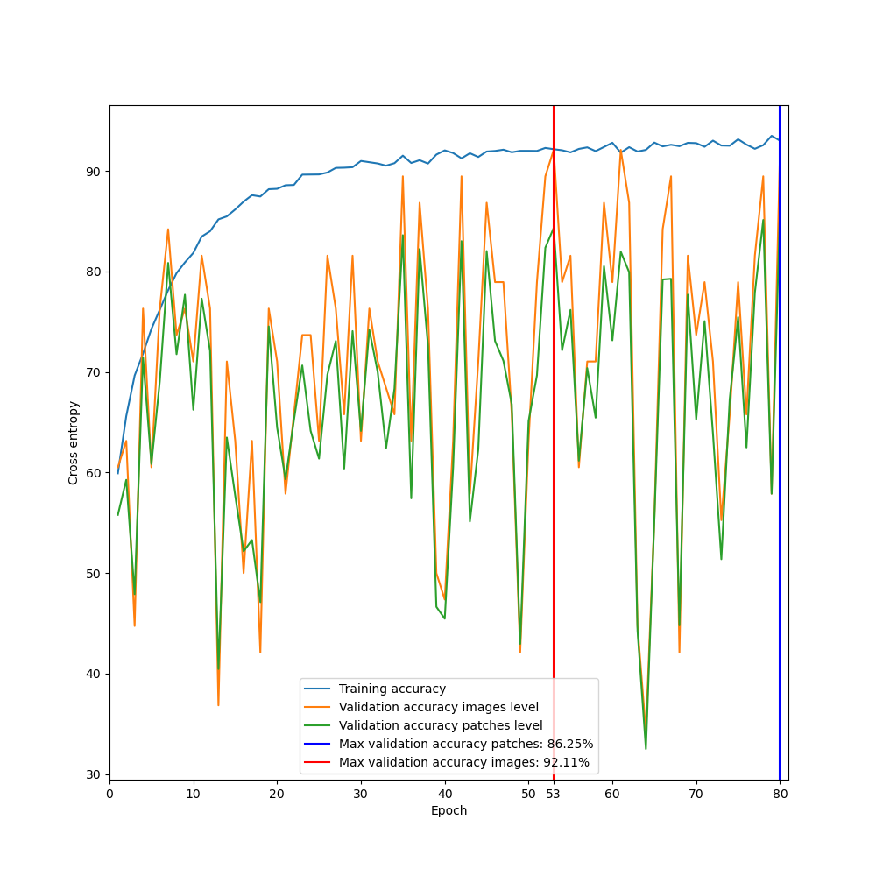
Complete model
MSE
Cross entropy
Accuracy

Slide 13
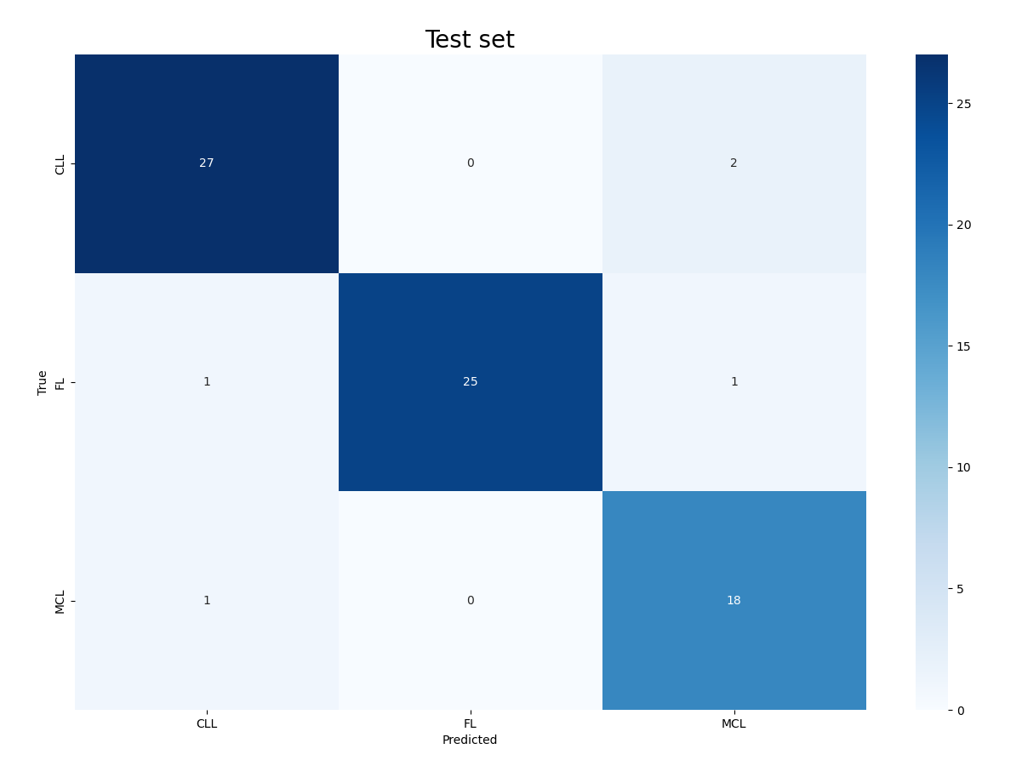
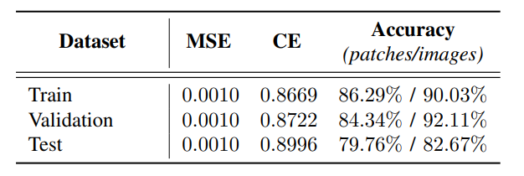
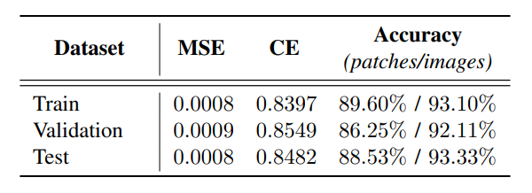
Complete model
Model with best accuracy images wise:
Model with best accuracy patches wise:

Slide 14
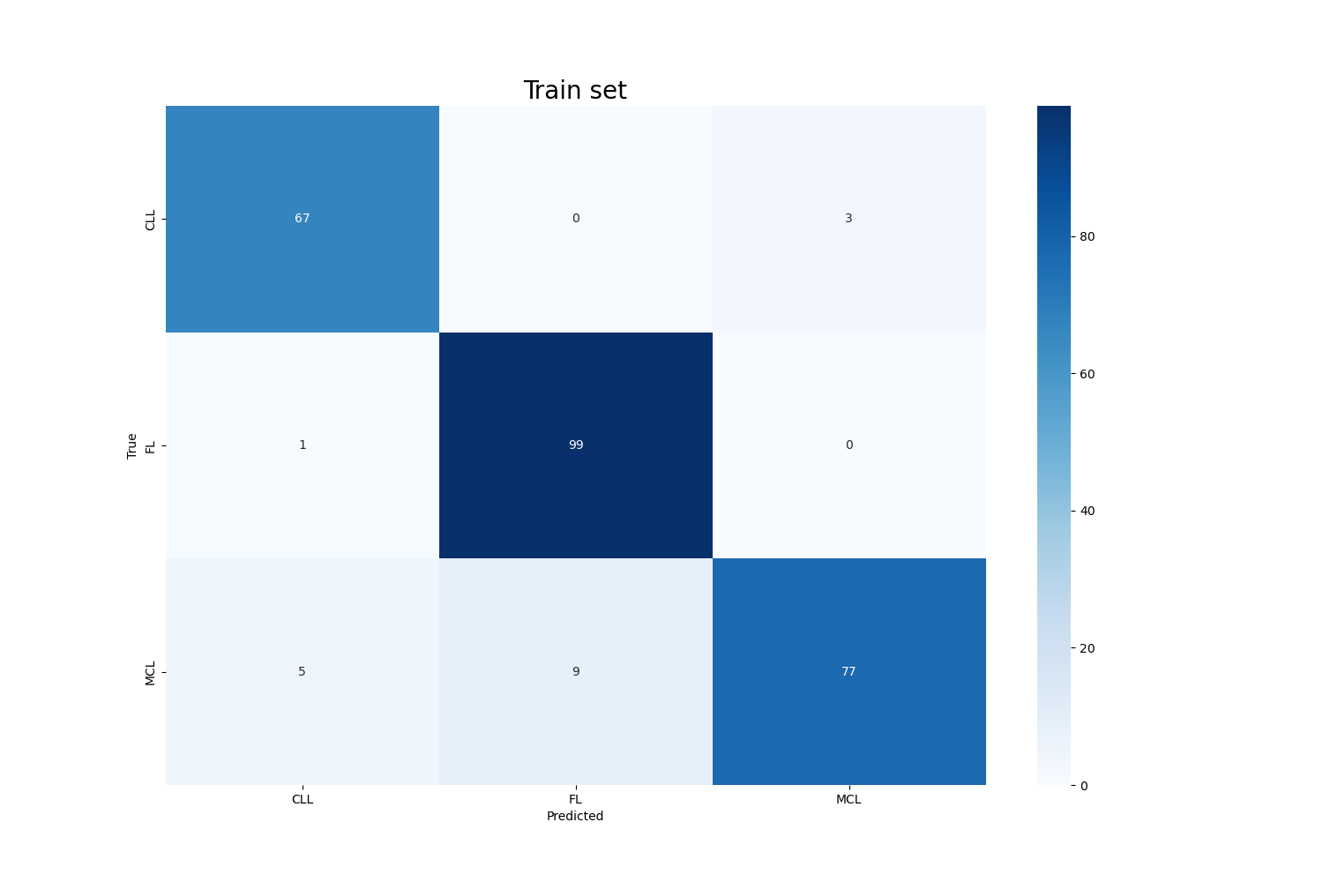


Advanced prediction algorithm
$$o_{img}=\sum_{patch ∈ 𝒮_{𝒾𝓂ℊ}}{o_{img,patch}}$$
Weighted sum of predictions →
The number of times label i was predicted as j → ${ C}_{i→j} =CM_{i,j}$
← Computed with the vanilla approach

Slide 15

Advanced prediction algorithm
If $\left|o_{img}^{i}−o_{img}^{j}\right|≤threshold$:
${\hat{y}}_{img}=\text{arg}\min_{k}\left(C_{h→k}\right)$, $k=i, h=j$ or $k=j, h=i$
Otherwise:
${\hat{y}}_{img}=\text{arg}\max_{k}\left(o_{img}^{k}\right)$, $k∈\{i,j\}$

Slide 16

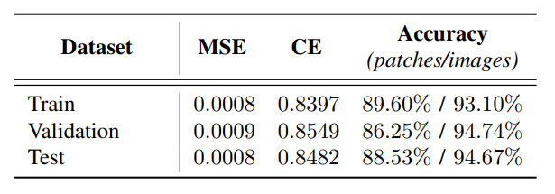
Complete model

Slide 17
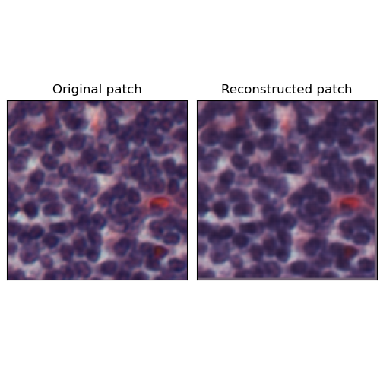
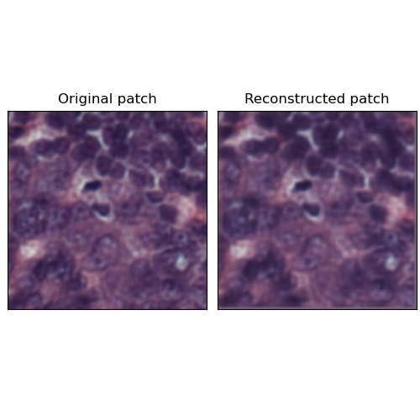
Reconstruction task

Slide 18
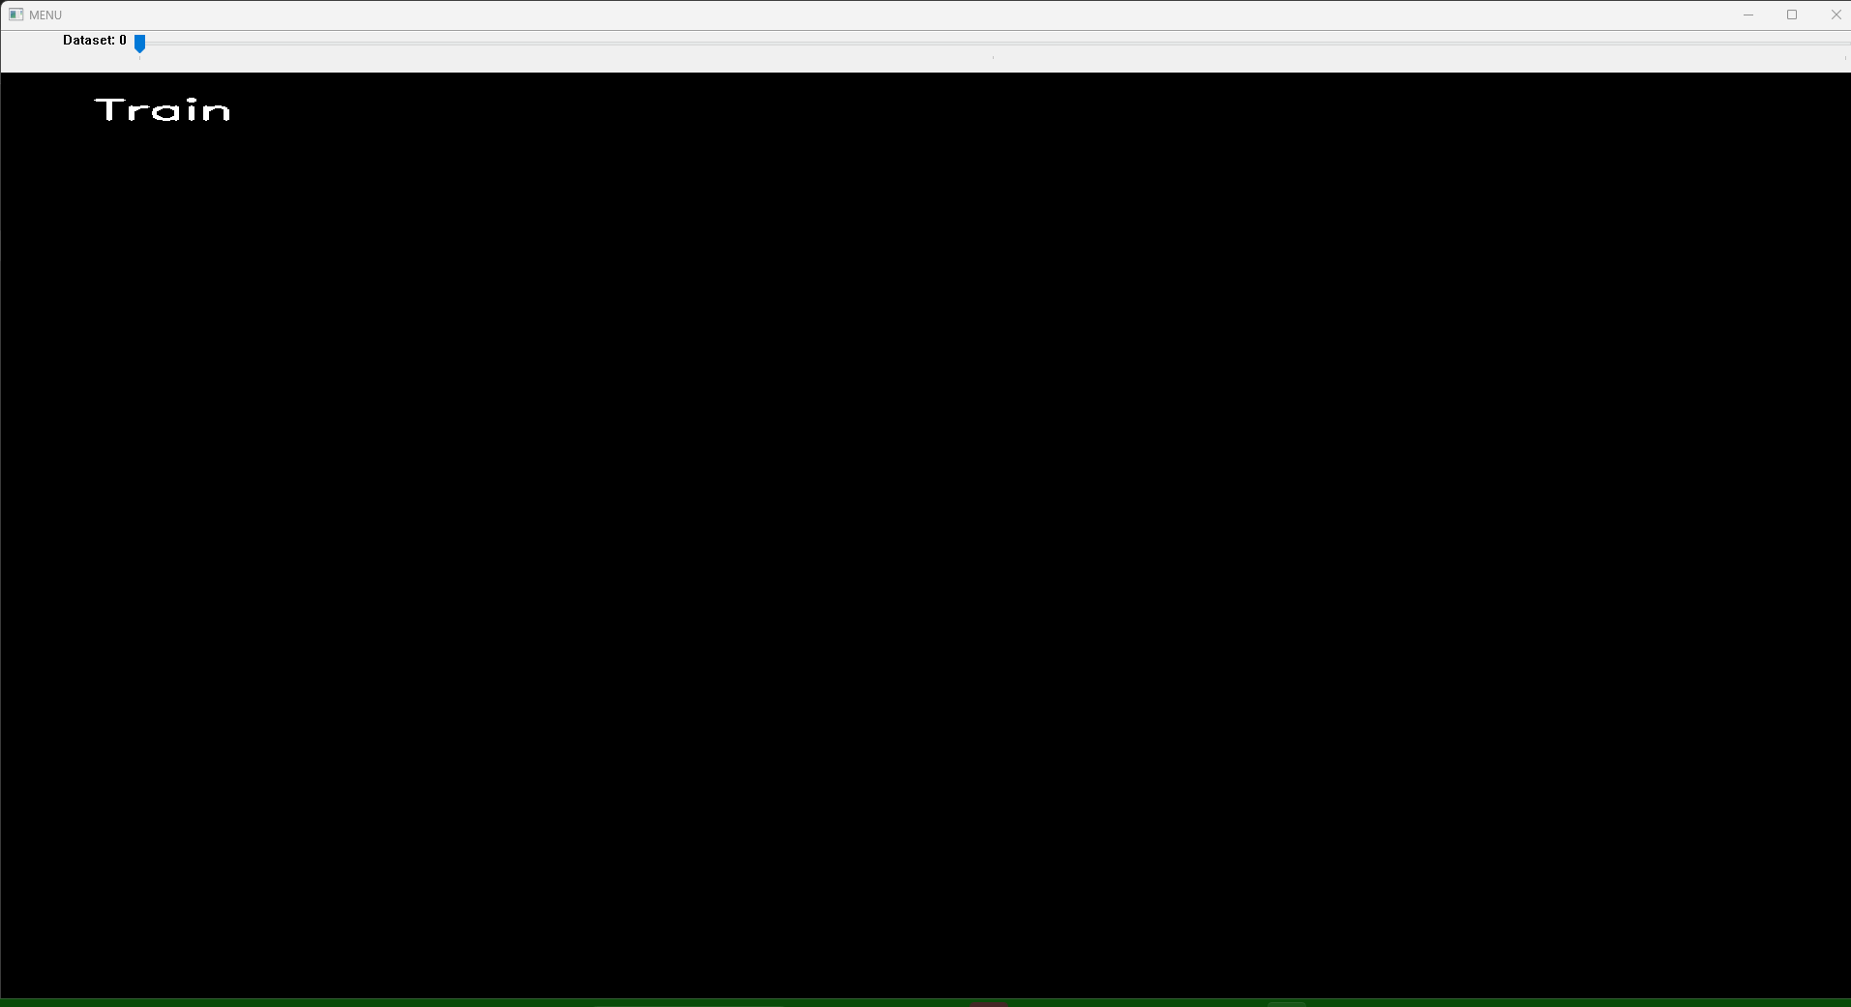
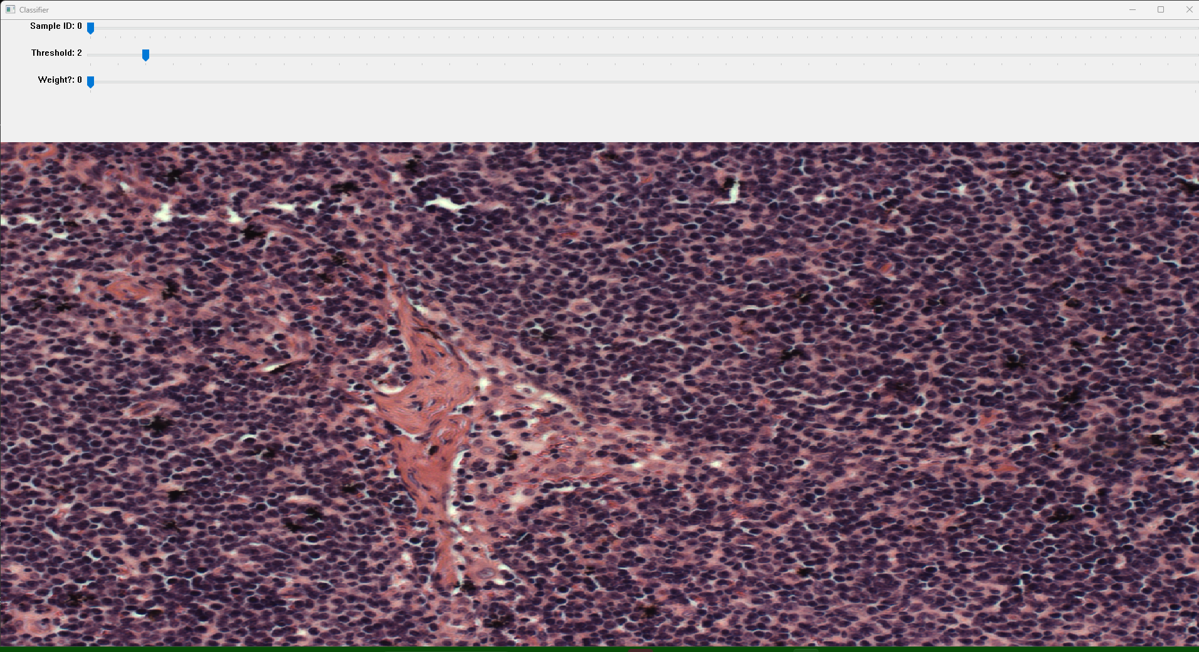
Output examples
Demo time ☺

Slide 19
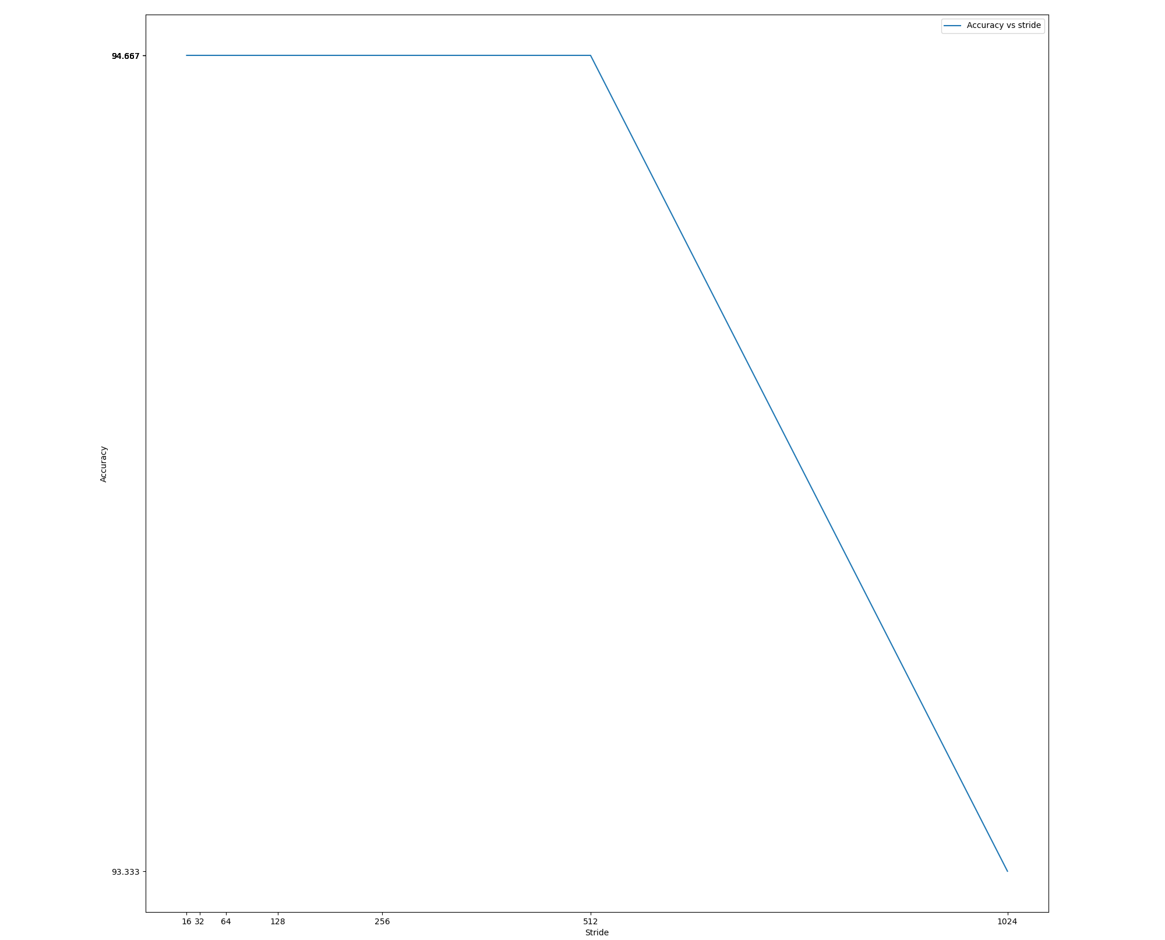
Sliding windows
= 6 patches

Slide 20
Time/space metrics
Number of parameters / Size of the network: 1531230 /5.84 MB
Time for an epoch (reading from the RAM):
26 s/epoch = 0.1 s/image = 0.002 s/patch
Time for the test (read from the local memory):
1min 36s = 0.37 s/image =0.01 s/patch
Results referred to the train dataset: 261 images with 40 patches each.
(PC: Ryzen 5800H, RTX 3060, 16GB of RAM)

Slide 21
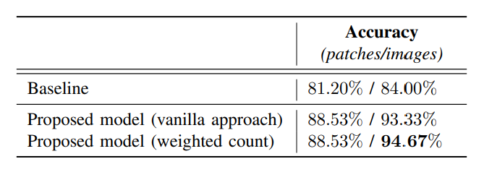
Conclusions

Slide 22
Thank you for your attention

